Slide 1



TASK TRACKER SYSTEM
CSA4309 - INTERNET PROGRAMMING FOR WEB SERVICES
Submitted by:
M.Deepthi (192210113)
S.Bhuvaneswari (192211813)
Under the Supervision of
Dr. K. Jayasakthi Velmurugan

Slide 2

INTRODUCTION
The program allows users to manage tasks with categories (e.g., "Work," "Personal Space") and subcategories. It includes a stopwatch and timer for real-time tracking of task durations, which are automatically logged. Users can filter tasks by category for focused task management. It supports CRUD operations: creating, viewing, updating, and deleting tasks.

Slide 3



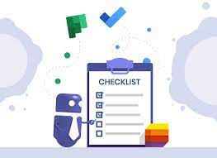
AIM
User-Friendly Platform: Create an intuitive interface for easy task management.
Secure User Authentication: Implement strong login/signup security to protect user privacy.
Task Organization & Prioritization: Allow users to categorize and prioritize tasks by status, importance, and deadlines.
Real-Time Task Tracking: Enable users to track progress and make adjustments in real-time.
Boost Productivity: Help users manage multiple tasks efficiently, enhancing overall productivity
WEB PAGE

Slide 4

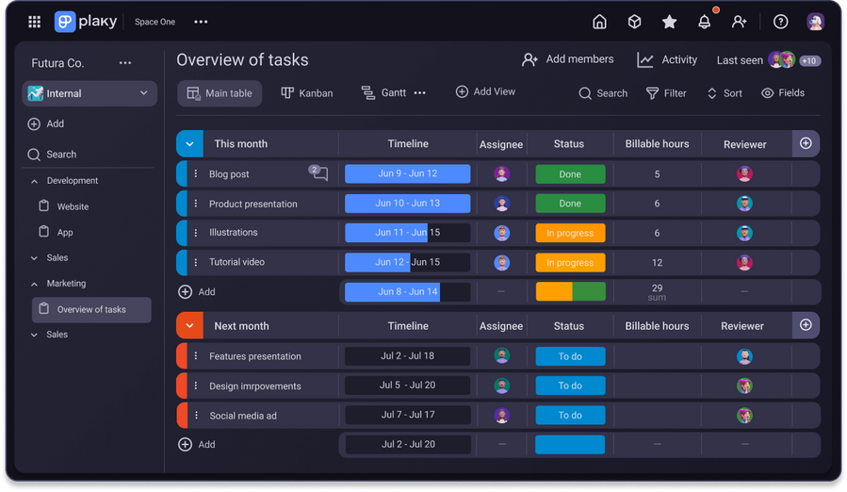

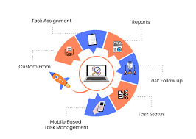
exisisting system
Manual Task Tracking
In existing systems, users often rely on physical notes, spreadsheets, or basic to-do lists, leading to inefficiency and difficulty in task prioritization.
Limited Task Categorization
Many current systems do not offer detailed categorization or filtering options, making it harder for users to organize tasks based on priority, deadlines, or specific categories.
Lack of User Authentication and Security
Traditional systems often lack secure user authentication, which can lead to issues with data integrity and privacy, especially when handling sensitive information.
Minimal Collaboration Features
Existing systems may not support collaboration or sharing between users, limiting team-based task management or preventing sharing of progress and updates.
No Integration with Notifications or Reminders
Many existing systems do not send timely notifications or reminders for approaching deadlines or updates, leading to missed tasks and reduced user productivity.

Slide 5


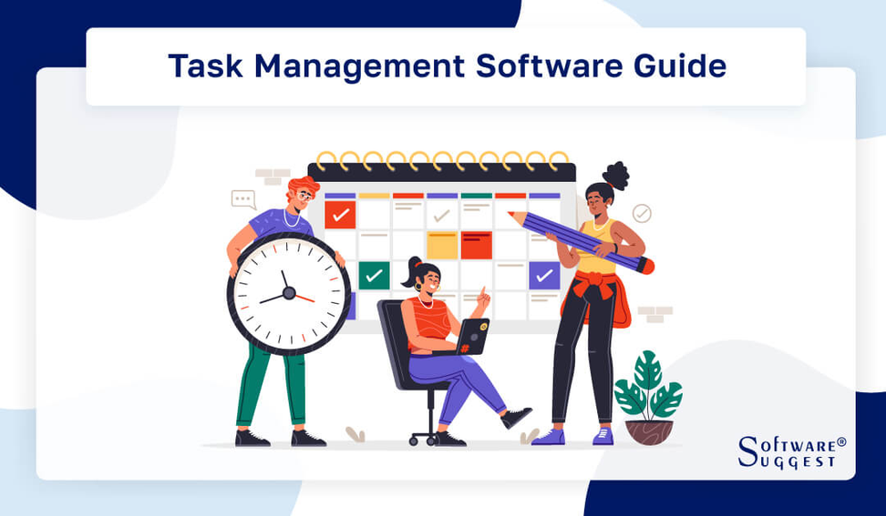
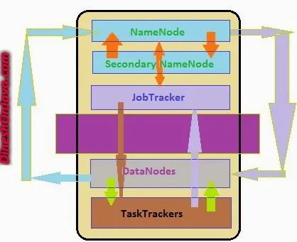
proposed sytem
Secure User Authentication and Management
The proposed system includes a robust user authentication process (login/signup functionality) to ensure data security and privacy, allowing only authorized access.
Advanced Task Categorization and Prioritization
Users can categorize tasks based on various factors such as deadlines, priority levels, and status, making it easier to manage and track tasks more efficiently.
Real-Time Task Updates and Modifications
The system allows users to make real-time updates to tasks, ensuring that any changes are instantly reflected and keeping users on track with their schedules.
Task Notifications and Reminders
The proposed system will include automated notifications and reminders for task deadlines or updates, helping users stay on top of their tasks and improving productivity.
Intuitive User Interface for Enhanced Usability
A clean, responsive, and user-friendly interface will be designed to ensure seamless interaction, making it easier for users to navigate the system on both desktop and mobile devices.

Slide 6
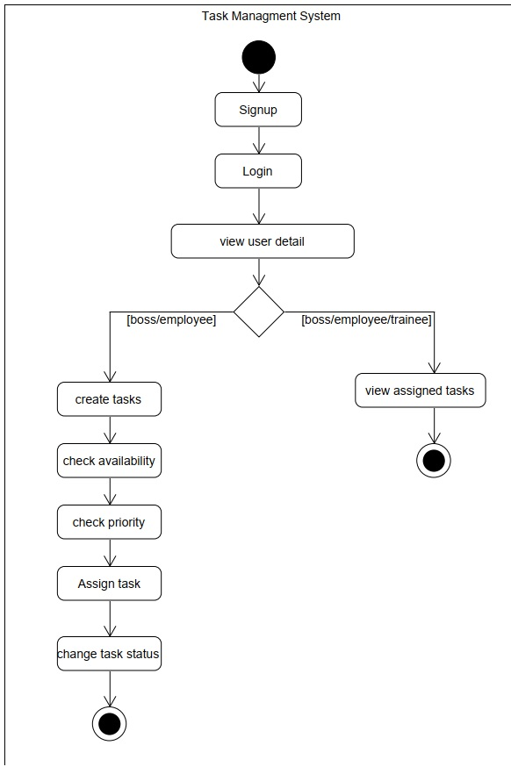

Block Diagram

Slide 7
module used
Frontend
It is the top most layer of the Architecture. Responsive, user-friendly interface built with HTML, CSS, and JavaScript to deliver an optimal browsing experience.
Backend
Powerful server-side logic using PHP to handle product management, order processing, and customer data management. Handles all the processing and decision making logic of the application.
Database
MySQL database for efficient storage and retrieval of product information, customer data, and transaction history.
Frontend
Backend
Database

Slide 8
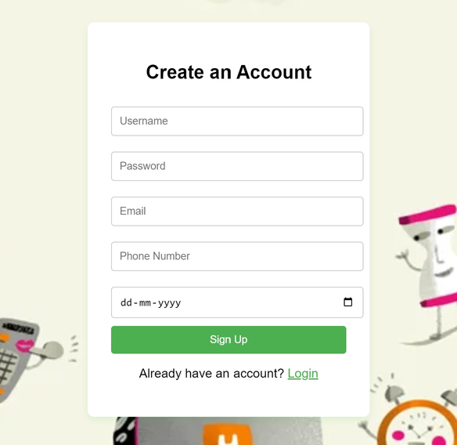
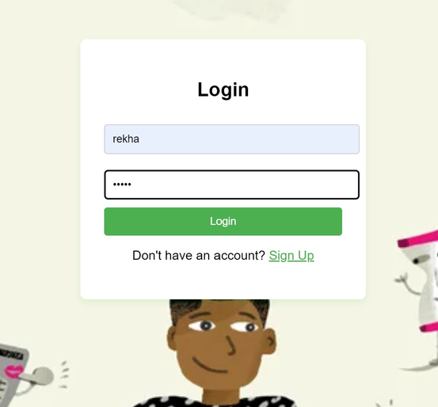
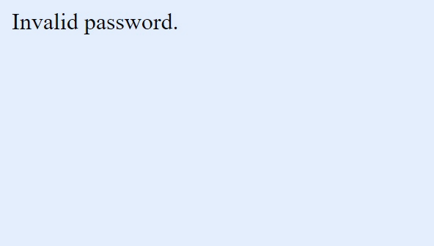
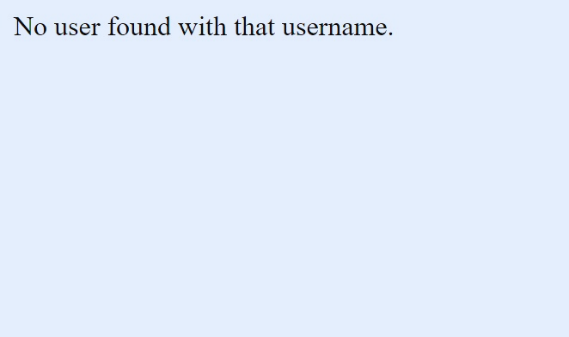
Output

Slide 9
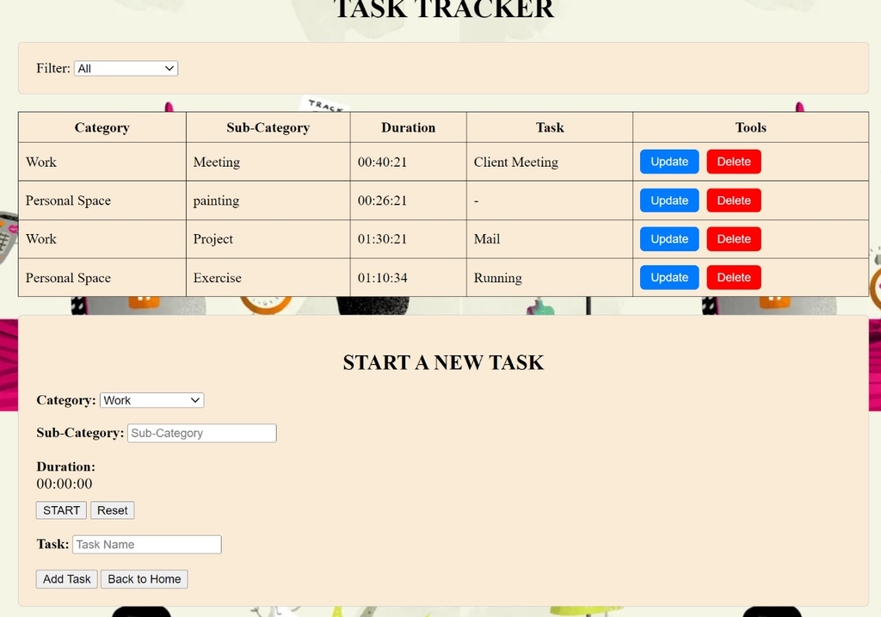
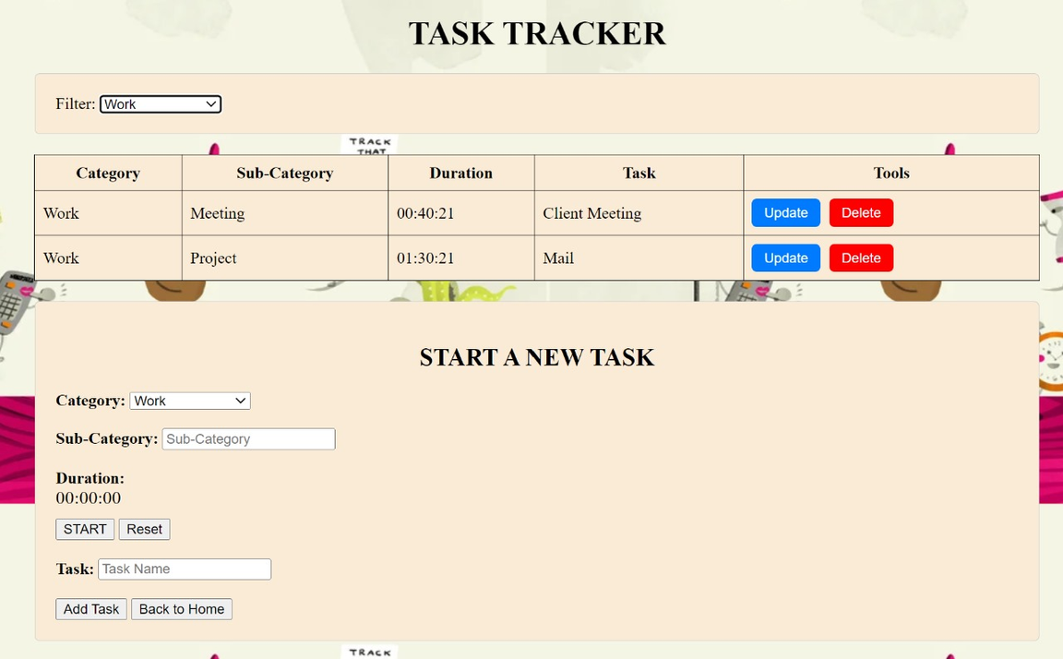
Output

Slide 10
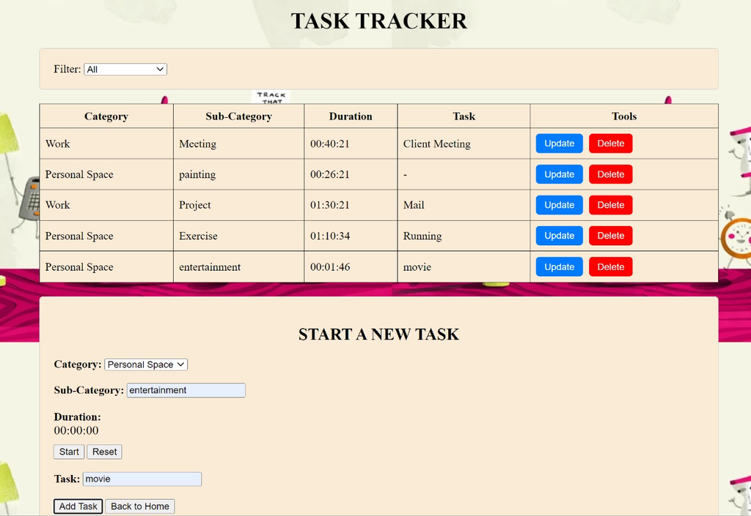

Output

Slide 11
conclusion
The Task Tracker Web Application provides an efficient and secure solution for managing tasks with features like user authentication, task creation, categorization, and real-time updates. By enabling task prioritization and availability checks, it enhances user productivity and organization. With its intuitive interface and task assignment functionalities, the system promotes seamless collaboration and ensures timely task completion. Future enhancements could include additional collaboration tools, mobile support, and advanced notifications, making it a comprehensive solution for task management.

Slide 12


